Slide 1

CLOUD COMPUTING OVERVIEW

Slide 2

CLOUD COMPUTING
What is Cloud Computing?
“Cloud computing” is the on-demand delivery of IT resources and applications via the Internet, with pay-per-use pricing.
On-demand: Available whenever needed
IT Resources: Compute, Storage, Applications, etc.
Pay-as-you-go: No need for upfront payment or buying things that you may not need
Available Online: Accessible over internet across globe
Cloud computing is to computing what Uber is to being driven in your own car by a chauffeur

Slide 3
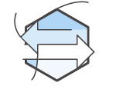


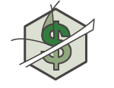
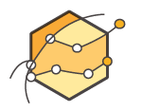

BENEFITS OF CLOUD COMPUTING
Trade capital expense for variable expense
Increase speed and agility
Benefit from massive economies of scale
Stop spending money on running and maintaining data centers
Stop guessing capacity
Go global in minutes

Slide 4
CLOUD ADOPTION DRIVERS
Start-ups
Agility is the biggest adoption driver
Speed: Go global in minutes
Experimentation: Lower the cost of trying
Culture of Innovation: Reduce the cost of failure
Scientific Research
Who are using cloud computing?
Over 1 million active customers in 190 countries
Over 2,000 government agencies
Lage Enterprise
5,000 academic institutions
7,500 non-profit organisations

Slide 5
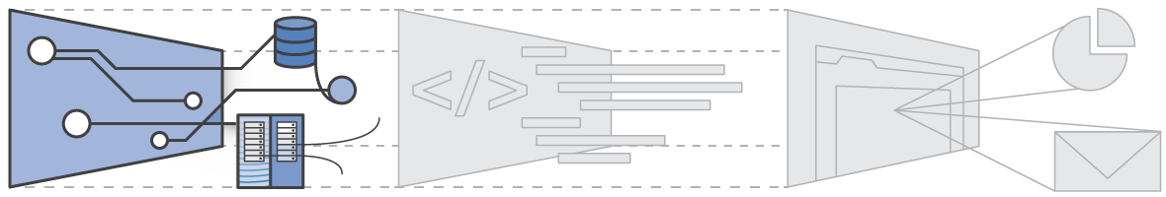
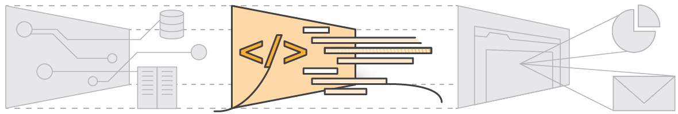
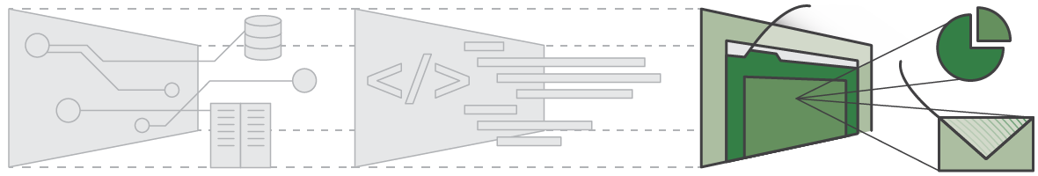
TYPES OF CLOUD COMPUTING
Infrastructure as a Service (IaaS):
Platform as a Service (PaaS):
Software as a Service (SaaS):

Slide 6
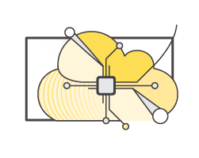
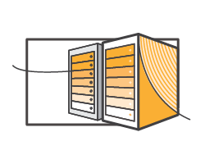
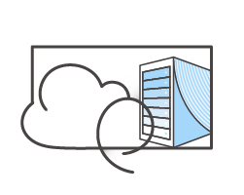
CLOUD DEPLOYMENT MODELS
Public Cloud: Cloud that is available over the internet, managed and maintained by a vendor
Private Cloud: A cloud system build within client’s premises, accessible only through client’s network
Hybrid Cloud: A cloud system where both public and private cloud can share resources

Slide 7
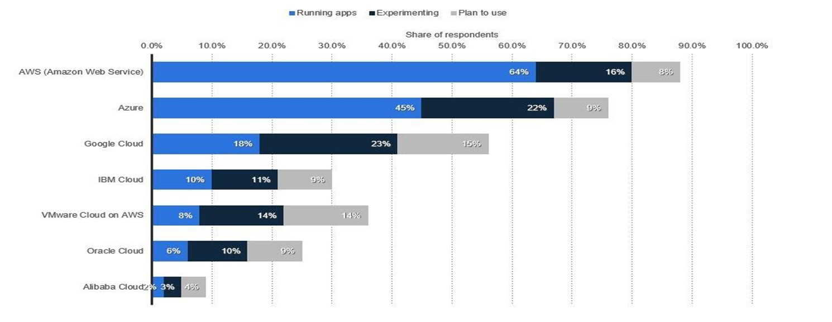
PUBLIC CLOUD ADOPTION
Current and planned usage of public cloud platform services running applications worldwide in 2018
Source: RightScale

